Slide 1
Workforce Development
September 2017
Notes:
Some of you may be familiar with NARI and others may not.
As we start, I want to briefly introduce you to NARI – and our members.
NARI is working hard to make a positive impact on the Skilled Labor Shortage in the US by proactively sharing the facts about this Nationwide concern.
Today we’ll touch on:
The Current State of the Industry
What you can do to support Workforce Development
NARI in Action
Local Efforts and initiatives

Slide 2
National Association of the Remodeling Industry (NARI)
NARI’s Core Purpose:
To advance and promote the remodeling
industry's professionalism, product and
vital public purpose.
Notes:
Read NARI’s Core Purpose –

Slide 3

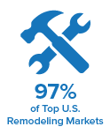
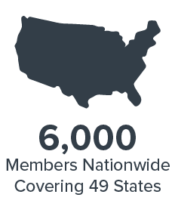
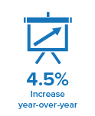

State of the Remodeling Industry
Notes:
6,000 Members Nationwide, covering 49 states and over 97% of top U.S. remodeling markets are represented by NARI members.
Our Industry thrives on having outstanding tradespersons to support the $355 Billion Remodeling Industry.
The Residential Remodeling Index, RRI, shows 20 straight quarters of growth and a predicted 4.5% increase year-over-year.
Our industry is developing leading edge programs to deliver more relevance and value to remodelers.
The baby boomers are on their way out of the workforce, we NEED skilled trade workers to fill the pipeline and fill their shoes. And while some jobs are being outsourced to other countries. A Tradesperons skills require a physical presence in the US.

Slide 4
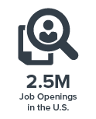
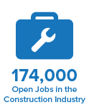

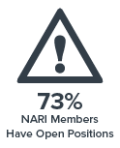
Industry Statistics
Notes:
There is a definite need for Skilled labor in the US. The statistics speak for themselves.
As the economy continues to recover from the housing collapse in 2007 and remodeling companies try to meet the demand,
they are finding that skilled carpenters, plumbers, and electricians are just not available.
There are currently:
2.5Million Skilled Trade job openings in the US ⁻ USA Today
And according to the Bureau of Labor Statistics as of November 2016, there were
174,000 open jobs in the construction industry and
for the 7th year in a row, Skilled Trades was the most difficult position to fill
We even found through our NARI 2017 member profile study conducted by a third party (Consumer Specialist) we had
73% of NARI Members have open positions

Slide 5
The question is:
How Do We Solve the
Issue of Not Enough
Skilled Tradespeople?
Notes:
The question is:
How Do We Solve the Issue of Not Enough Skilled Tradespeople?

Slide 6
The Answer is:
YOU
Notes:
The Answer is: YOU

Slide 7



Opportunity is Knocking
Consider a Career with:
Job Security
Excellent Starting Pay
High Advancement Potential
Notes:
Who in the audience would pass up an opportunity for a career that has:
Job Security
Excellent Starting Pay
High Advancement Potential
It is an offer that you have to consider for either yourself or a student searching for their calling.

Slide 8


Education Benefits
Save Time
Lower Cost = Less Debt
Focus and Direction
Flexibility
Industry Connections
Add image of Students in all ages
Notes:
Not only that but the benefits include:
Save Time: College typically takes 4 years to complete while most trade school programs average 2yrs. Plus 40% of attendees at a 4yr college drop out before completing their degree with 64% taking longer than 4 years to graduate ³.
Lower Cost = Less Debt: The average cost of a 4yr degree is $127,000 compared to an estimated $33,000 for a trade school degree. The math is easy.
Focus and Direction: Learn a specialized skill through small class sizes and hands-on learning. Get a competitive advantage by knowing exactly what you will be doing on the job.
Flexibility: Most programs offer night, weekend and online classes for certifications.
Industry Connections: Industry professionals partner with local trade schools through job placement programs.

Slide 9
A Career Path
Notes:
Choosing a Career as a Skilled Tradesperson is rewarding and can lead to owning your own business, Honing a craft and securing your financial future.

Slide 10

NARI’s Response
Notes:
So what is NARI doing?
NARI has created a Workforce Development Taskforce which provides recommendations to foster the development of the remodeling industry’s future workforce. Including:
Messaging to public schools and community colleges
Support to local chapters regarding technical college partnerships
Education programs targeting entry level or potential employees
Working with veterans’ groups to locate potential skilled trades and entry level workers
Supporting National Legislation to Support the growth/promotion of Skilled Labor

Slide 11






Making an Impact
Notes:
NARI is actively building alliances to help make an impact: one example –
Pro Remodeler Magazine started Skilled Labor Fund with NARI, NKBA, NAHB and the National Housing Endowment and it was rolled out at the IBS/KBIS in Orlando this past January.
There’s much to be done … and we are only at the beginning of the process but NARI is committed to working to make a positive impact.

Slide 12
NARI-Chapter Supports a Solution Locally
Notes:
Locally, XXXX
There’s much to be done … and we are only at the beginning of this Workforce Development process, who here is committed to being part of the solution?
Does anybody here have positive experience in their local communities impacting the skilled trade shortage that they can share?

Slide 13
THANK YOU
QUESTIONS?
Notes:
Thank you for the opportunity to share with you all. Are there any questions?

